Slide 1
HOW TO READ A
RESEARCH PAPER

Slide 2
TWO TYPES OF SCIENTIFIC PAPERS CONTAINING TWO TYPES OF INFORMATION
There are two types of scientific papers:
Review articles: give an overview of the scientific field or topic by summarizing the data and conclusions from many studies.
Primary research articles: contain the original data and conclusions of the researchers who were involved in the experiments and how the experiments were done.

Slide 3
A PRIMARY RESEARCH ARTICLE REPORTS ON AN EMPIRICAL RESEARCH STUDY CONDUCTED BY THE AUTHORS. IT IS ALMOST ALWAYS PUBLISHED IN A PEER-REVIEWED JOURNAL. THIS TYPE OF ARTICLE:
Asks a research question or states a hypothesis or hypotheses
Identifies a research population
Describes a specific research method
Tests or measures something
Includes a section called "method" or "methodology." This may only appear in the article, not the abstract.
Includes a section called "results."
slide <number>

Slide 4
TO CONTRAST, THE FOLLOWING ARE NOT PRIMARY RESEARCH ARTICLES (I.E., THEY ARE SECONDARY SOURCES):
Literature reviews
Meta-Analyses/Review articles (These are studies that arrive at conclusions based on research from many other studies.)
Editorials
Letters
Chapters in books
Encyclopedia articles
Speeches and interviews
slide <number>

Slide 5

FEW EASY WAYS TO DISTINGUISH BETWEEN REVIEW & PRIMARY RESEARCH
Many reviews will be labeled as "review“ on the first page of the article.
Reviews don't have a "methods" section.
In a review article, graphs, tables,
or figures containing actual data will
contain citations in the figure legend
to the primary research papers that
originally reported the findings.

Slide 6
RESEARCH PAPERS
Primary form in which research results are disseminated in any field.
Conference papers (shorter)
Journal papers (longer)
  Often the complete version of a conference paper
  May come out several years after the conference paper

Slide 7
WHY BOTHER OURSELVES?
Journal papers are current
  Textbooks are often years out of date.
  Journals are generally the most accessible means of obtaining the information that you need.
You can get a good explanation for your data and enough details to replicate what you read about.
To find out exactly what the latest developments are in a field.
To find out how a certain piece of research was done.
Because one day soon you could be writing papers too!

Slide 8
READING A PAPER CRITICALLY
Understand the problem
Understand the proposed solution
Understand competing approaches / designs
Evaluate the paper
Peer review is the cornerstone of the scientific publishing process

Slide 9
WHY?
Learn to do research
Learn to think critically about quality of research papers
  Someone will be thinking critically about your own work!
  In any discipline, there are fads and there are lasting ideas… learn to tell the difference!
Gain perspective
Key issue: what are the questions to ask?

Slide 10
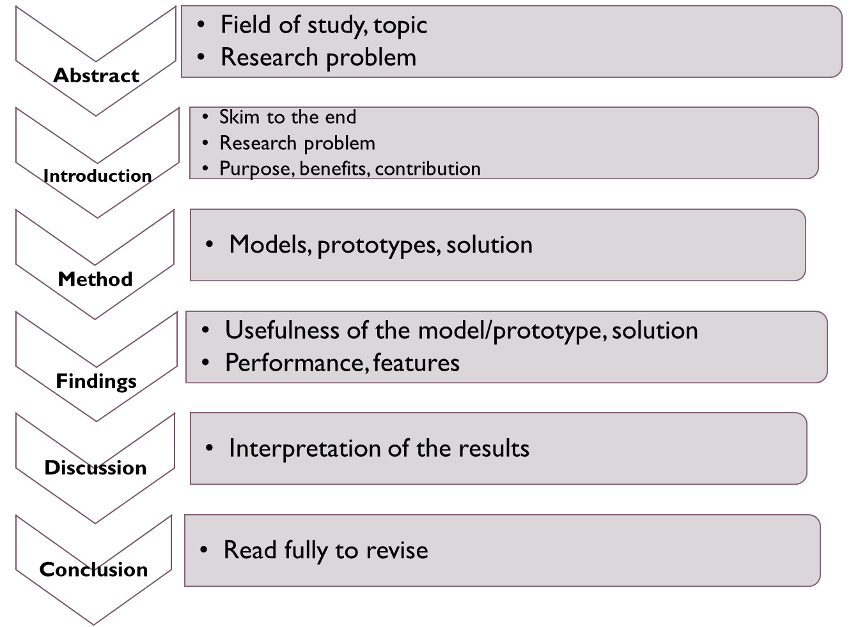
ANATOMY OF A RESEARCH ARTICLE
slide <number>

Slide 11
EVALUATING A PAPER
What is the problem being solved?
  Is it important? Relevant? Why?
  What is the prior work in this area?
Is the proposed solution clever?
Are the assumptions and model reasonable?
Impact
  Easier to evaluate for older papers
  Does other work build on it? Do other papers use techniques and solutions proposed in this paper?

Slide 12
EVALUATION PROCESS
Read slowly, take notes as you read.
  Question assumptions, importance of the problem
  Write questions to track what you don’t understand
Sometimes what is not in the paper is more important than what is in it.
  Is there something the authors have overlooked?
Don’t let ideas or design details pass until you understand them!
Do not assume the paper is correct, even if published in a prestigious peer-reviewed venue.

Slide 13
GROUND RULES
Try to understand
Don’t be afraid to ask
Be constructive
Be polite
Don’t be afraid to criticize (constructively!)

